Slide 1
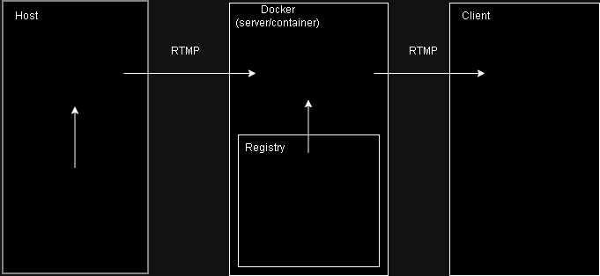






Host stream
Client view stream
Camera

